Slide 1
ANTHEM
By Ayn Rand

Slide 2
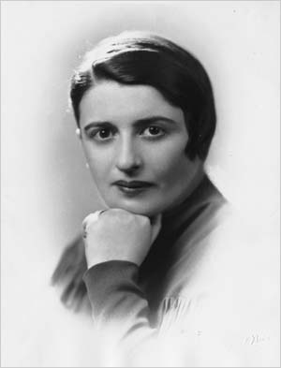
About the Author…. Ayn Rand
Was born in St. Petersburg, Russia
Born Alissa Zinovievna Rosenbaum
Strongly opposed to collectivism
Advocate for minimalist government
When introduced to American history in her last year of high school, she immediately took America as her model of what a nation of free men could be.
In late 1925 she obtained permission to leave Soviet Russia for a visit to relatives in the United States. Although she told Soviet authorities that her visit would be short, she was determined never to return to Russia.
She ventured to Hollywood where she wrote screenplays
Some of her other works include Atlas Shrugged and Fountainhead

Slide 3
Some ideas that anthem covers
Government’s role
Individualism
Collectivism
Egoism
Reason
Irrationality
Power of thought and language

Slide 4
Let’s Compare
Individualism
Collectivism
The individual’s life belongs to him and that he has an inalienable right to live it as he sees fit, to act on his own judgment, to keep and use the product of his effort, and to pursue the values of his choosing.
The idea that the individual’s life belongs not to him but to the group or society of which he is merely a part, that he has no rights, and that he must sacrifice his values and goals for the group’s “greater good.”

Slide 5
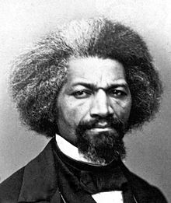
May I have a word with you…
'I am myself; you are yourself; we are two distinct persons, equal persons. What you are, I am. You are a man, and so am I. God created both, and made us separate beings…We are distinct persons, and are each equally provided with faculties necessary to our individual existence. In leaving you, I took nothing but what belonged to me, and in no way lessened your means for obtaining an honest living. Your faculties remained yours, and mine became useful to their rightful owner.'"

Slide 6
EGO
Initially the ego is “that part of the id which has been modified by the direct influence of the external world” (Freud 1923). The ego develops in order to mediate between the unrealistic id and the external real world.
Ideally the ego works by reason whereas the id is chaotic and totally unreasonable. The ego operates according to the reality principle, working our realistic ways of satisfying the id’s demands, often compromising or postponing satisfaction.

Slide 7
A different kind of society
Utopian
Dystopian
A place, state, or condition that is ideally perfect in respect of politics, laws, customs, and conditions.
A futuristic, imagined universe in which society is maintained through corporate, bureaucratic, technological, moral, or totalitarian control.

Slide 8
The main character in this novella is a Dystopian Protagonist
Often feels trapped and is struggling to escape.
Questions the existing social and political systems.
Believes or feels that something is terribly wrong with the society in which he or she lives.
Helps the audience recognizes the negative aspects of the dystopian world through his or her perspective.

Slide 9
Characteristics of a Dystopian Society
Propaganda is used to control the citizens of society.
Information, independent thought, and freedom are restricted.
Citizens are perceived to be under constant surveillance.
The natural world is banished and distrusted.
Citizens conform to uniform expectations. Individuality and dissent are bad.
The society is an illusion of a perfect utopian world.

